Slide 1

Mini Project Even Semester Session 2024-25
<SMART CITY (smart parking ) >
<VIBHOR TYAGI 202410116100240>
<YATHARTH TYAGI 202410116100254>
Project Supervisor:
MS. Shruti mam
ASST professor

Slide 2
Content
Introduction
Literature Review
Objective of the Project (
Technology
Hardware Requirements (Development Environment, Server requirement (if required), Client requirement (if required).
Software Requirements (Language and Platforms like Frameworks, VS code, Android Studio and Jupyter notebook etc. )
Modules
Workflow
References

Slide 3
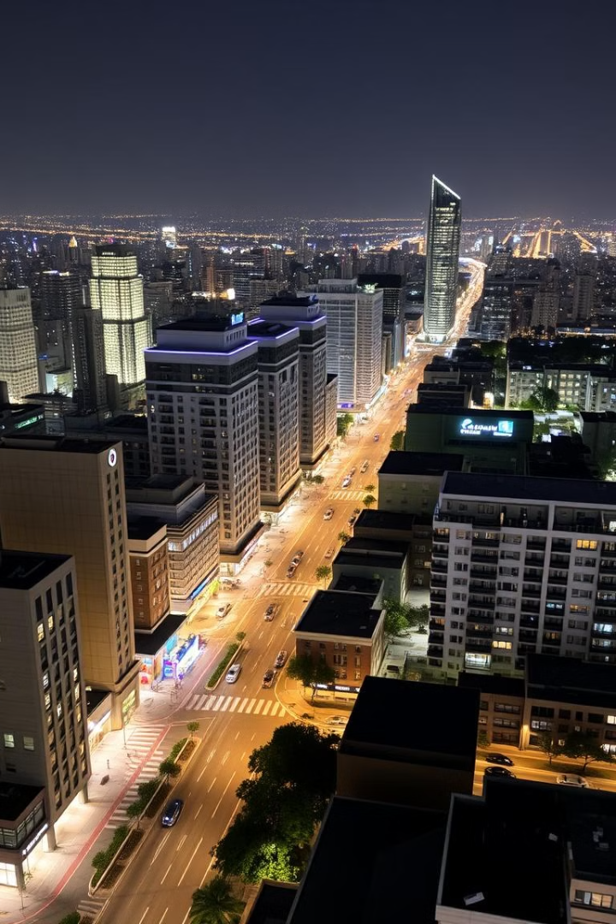
Introduction to Smart Cities smart parking
Smart cities/parking use technology to improve urban services like energy, transportation, and utilities. This global market is expected to reach $2.5 trillion by 2025. Key elements include data collection, analysis, and action.

Slide 4
Literature Review: Defining Smart Cities
Key Research
Current Debate
"Smart Cities: An Overview" (Journal of Urban Technology, 2018) discusses the evolution of the smart city concept and its key components. "The Rise of the Smart City" (Technological Forecasting and Social Change, 2020) analyzes the factors driving the growth of smart cities globally.
There are varying perspectives on the role of technology in urban development.

Slide 5
Literature Review: Challenges and Opportunities
Challenges
Opportunities
Data privacy and security concerns are significant. Barcelona's smart city infrastructure faced cybersecurity threats in 2021. The digital divide and social inclusion are also major concerns.
Smart cities offer improved resource management and sustainability, as well as enhanced citizen engagement and participation. Amsterdam's Smart City project reduced energy consumption by 20% through smart grids.

Slide 6
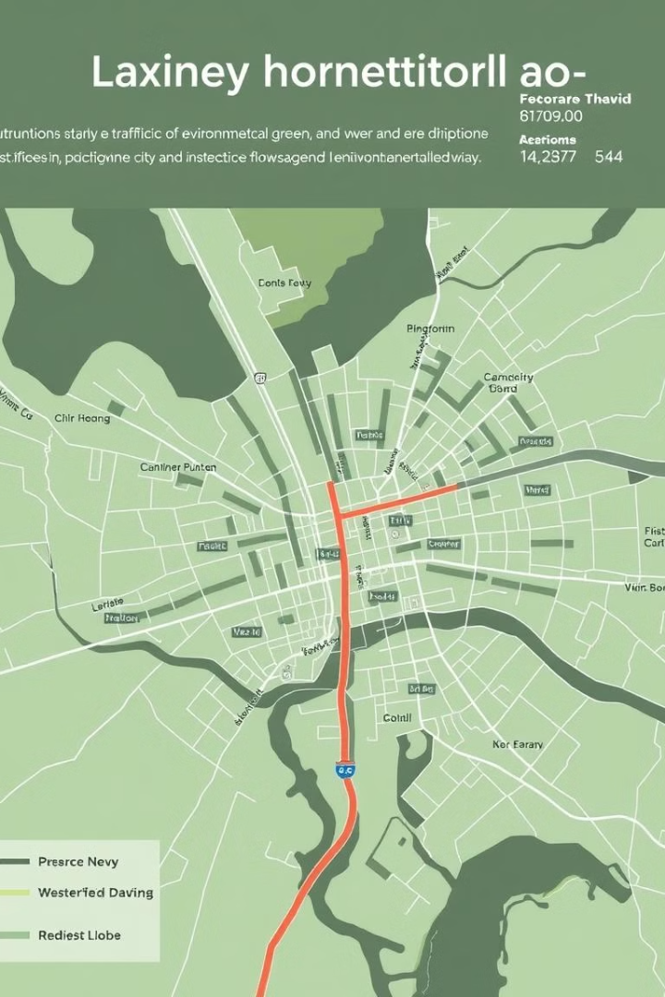
Project Objective: Developing a Smart City Solution
1
This project aims to design and implement a smart city solution for [Specific City Name].
2
The key goals are to enhance traffic management and reduce congestion by 30%, improve public safety through real-time surveillance and response, optimize energy consumption and reduce carbon emissions by 15%, and enhance citizen engagement and access to public services.
3
We will measure success by quantifiable improvements in key performance indicators (KPIs).

Slide 7
Core Technologies for Smart City Implementation
Internet of Things (IoT)
Big Data Analytics
Cloud Computing
Connecting devices and sensors to collect real-time data. Example: Smart streetlights, smart parking sensors.
Processing and analyzing large datasets to identify patterns and insights.
Providing scalable and cost-effective infrastructure for data storage and processing.
Artificial Intelligence (AI)
5G Connectivity
Enabling automated decision-making and predictive analytics.
Providing high-speed, low-latency communication for critical applications.

Slide 8
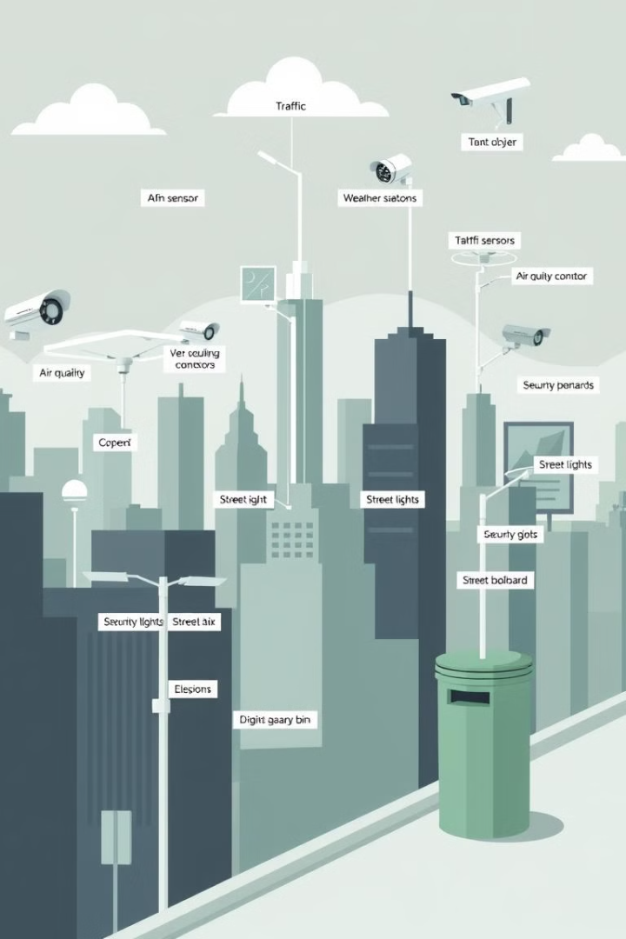




Hardware Requirements
Sensors: Traffic sensors, environmental sensors, air quality monitors, smart meters.
Communication Infrastructure: 5G base stations, Wi-Fi hotspots, fiber optic cables.
Computing Devices: Edge servers, data centers, embedded systems.
Security Devices: Surveillance cameras, access control systems.
We plan to deploy approximately 10,000 smart sensors across the city.

Slide 9
Software Requirements
Data Management
Analytics Software
Application Development
Security Software
Data Management Platform: Collecting, storing, and processing data from various sources. Example: Hadoop, Spark.
Performing data analysis and generating insights. Example: Tableau, Power BI.
Protecting data and infrastructure from cyber threats. Example: Firewalls, intrusion detection systems.
Building and deploying smart city applications.

Slide 10
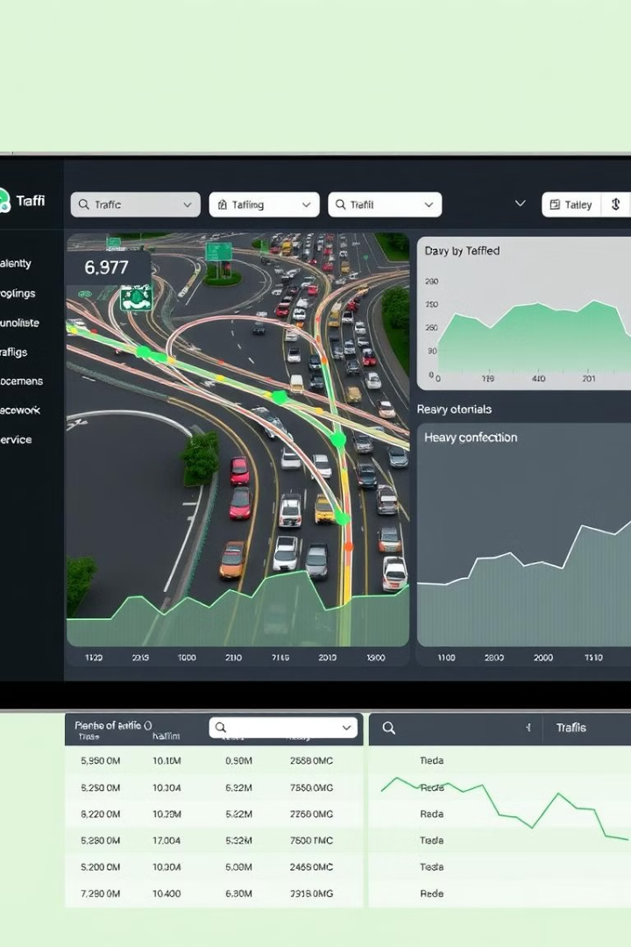
Smart City Modules: Traffic Management
1
Intelligent Traffic Management System
Real-time traffic monitoring using sensors and cameras. Adaptive traffic signal control based on traffic conditions. Predictive traffic forecasting using AI algorithms.
2
Smart Parking System
Real-time parking availability monitoring using sensors. Mobile app for finding and reserving parking spaces. Dynamic pricing based on demand.
These modules are expected to reduce traffic congestion by 30% and increase parking efficiency by 25%.

Slide 11
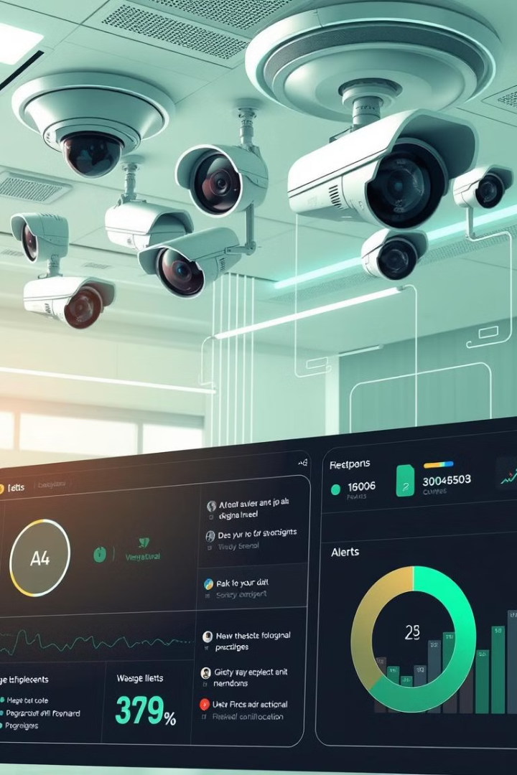


Smart City Modules: Public Safety and Energy Management
Smart Surveillance System
Real-time video analytics for crime detection and prevention. Facial recognition and license plate recognition. Integration with emergency response systems.
Smart Energy Management System
Real-time energy consumption monitoring using smart meters. Predictive energy demand forecasting using AI algorithms. Automated control of energy distribution.
The smart surveillance system aims to reduce the crime rate by 15%, while the smart energy management system targets a 15% reduction in energy consumption.

Slide 12
Workflow: Data Collection, Analysis, and Action
Data Collection
Sensors and devices collect data from various sources.
Data Transmission
Data is transmitted to a central data management platform.
Data Analysis
Data is analyzed to identify patterns and insights.
Decision Making
Decisions are made based on the insights gained.
Action
Actions are taken to improve the performance of urban services.
The process is continuously monitored and improved to optimize outcomes.

